Slide 1
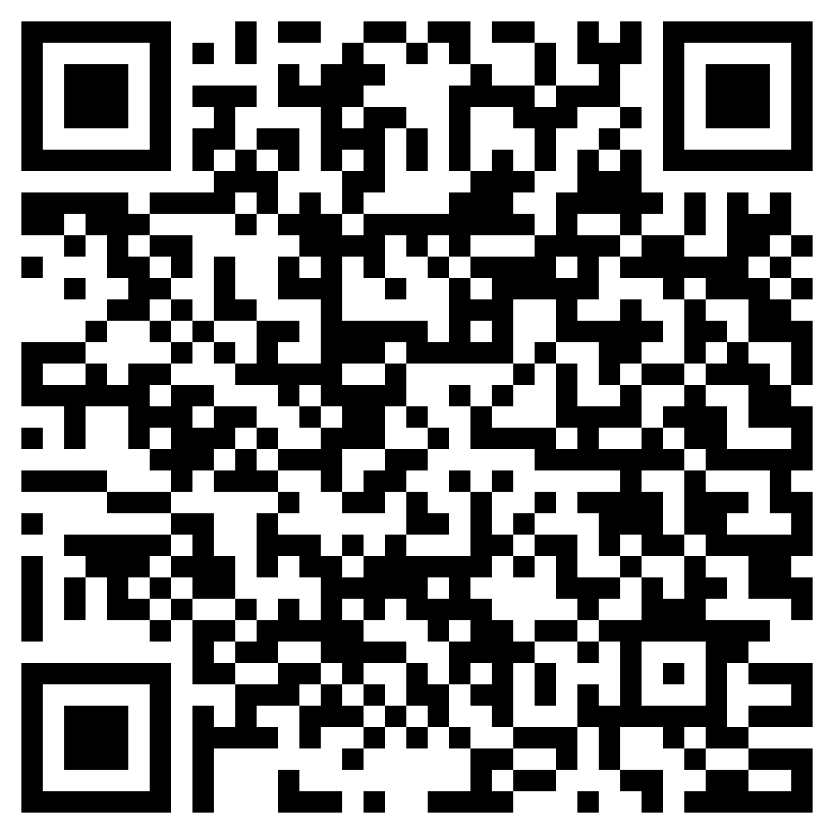
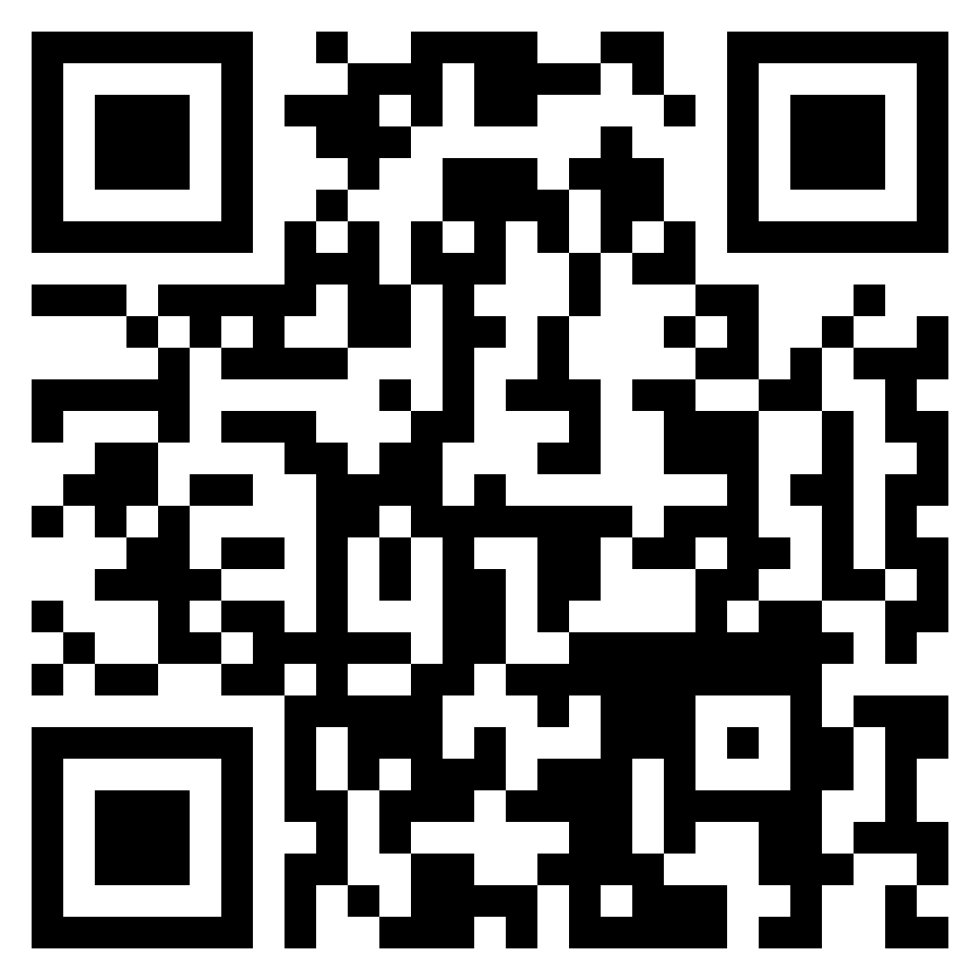
Open Source HK Meeting
NVIDIA Jetson and Computer Vision
By Ethan Lee
Slides
Github

Slide 2


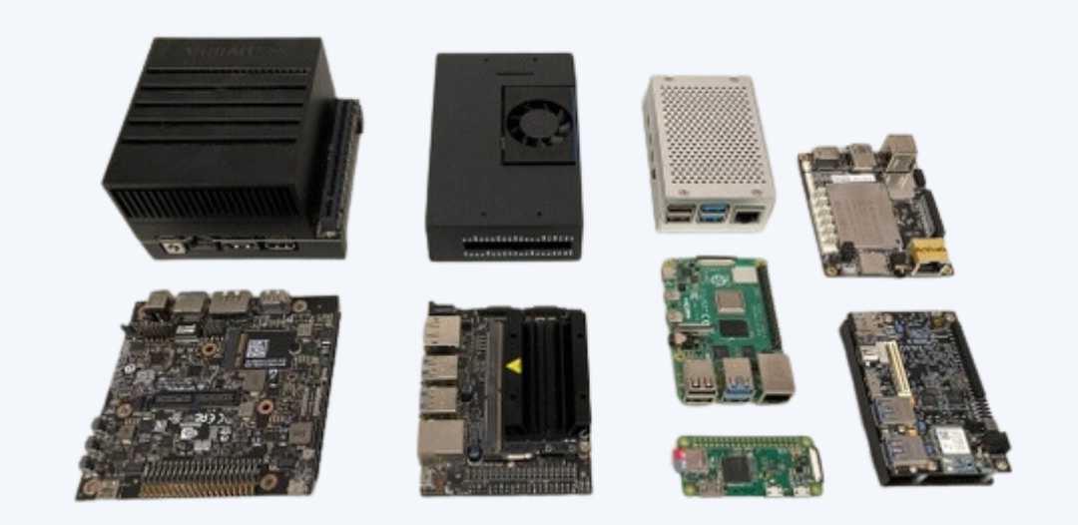
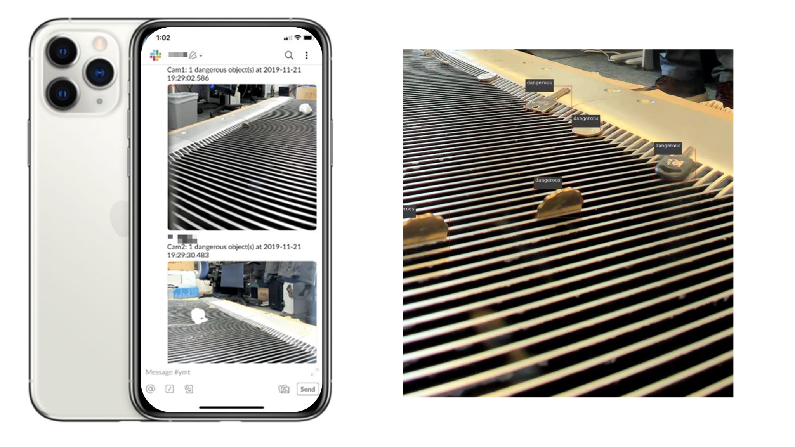
Self-Introduction
Computer Vision Engineer @ Sebit Company Limited
Sebit – A tech company focusing on AI, Computer Vision and 3D visualization.
Developing Computer Vision softwares, implement in edge AI devices.
BSc in Physics from CUHK. Focus on theoretical & computational physics.
photos from https://www.sebit.world

Slide 3
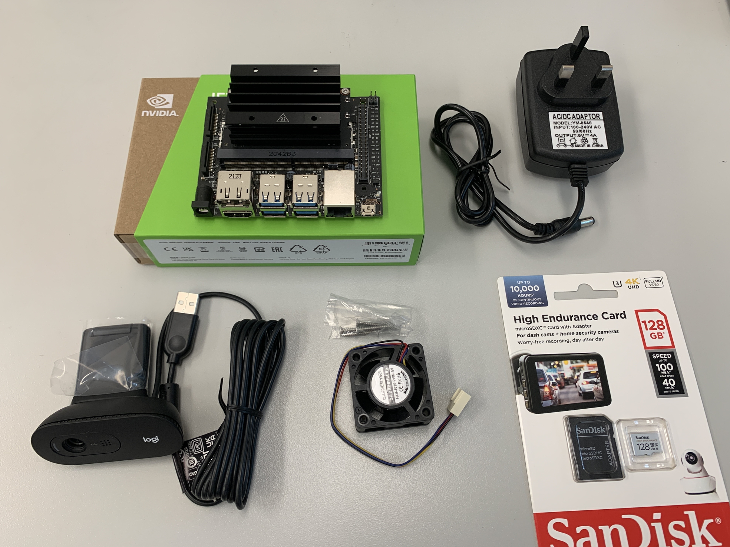
Equipment list
SD card (at least 32GB)
Jetson Nano Develpoer Kit
Power Supply (5V @ 4A)
USB Camera (720p)

Slide 4
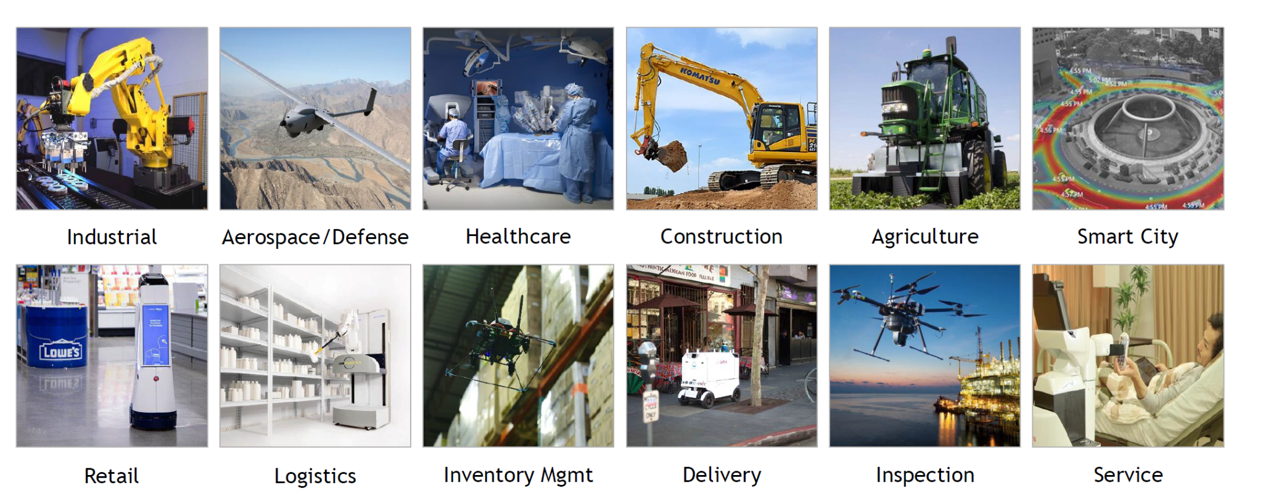
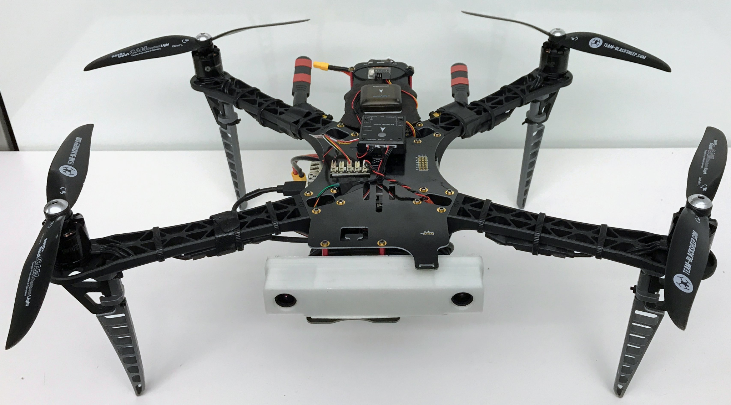
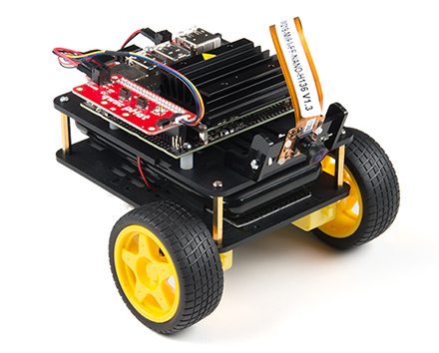
Introduction to Jetson Series
NVIDIA Jetson Series
Designed for AI and robotics applications.
Hardware accelerated for deep learning and computer vision tasks.
Small form factor, power efficient → Used in autonomous vehicles, drones, robots, smart city, etc.
Notes:
https://developer.nvidia.com/embedded/jetson-modules
https://developer.nvidia.com/blog/nvidia-jetson-project-of-the-month-an-ai-powered-autonomous-miniature-race-car-gets-on-track/
https://github.com/NVIDIA-AI-IOT/redtail/wiki/Skypad-TBS-Discovery-Setup
https://www.nvidia.com/en-us/autonomous-machines/embedded-systems/jetbot-ai-robot-kit/

Slide 5
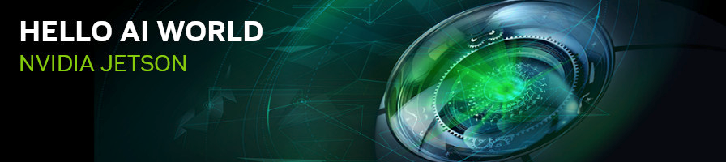
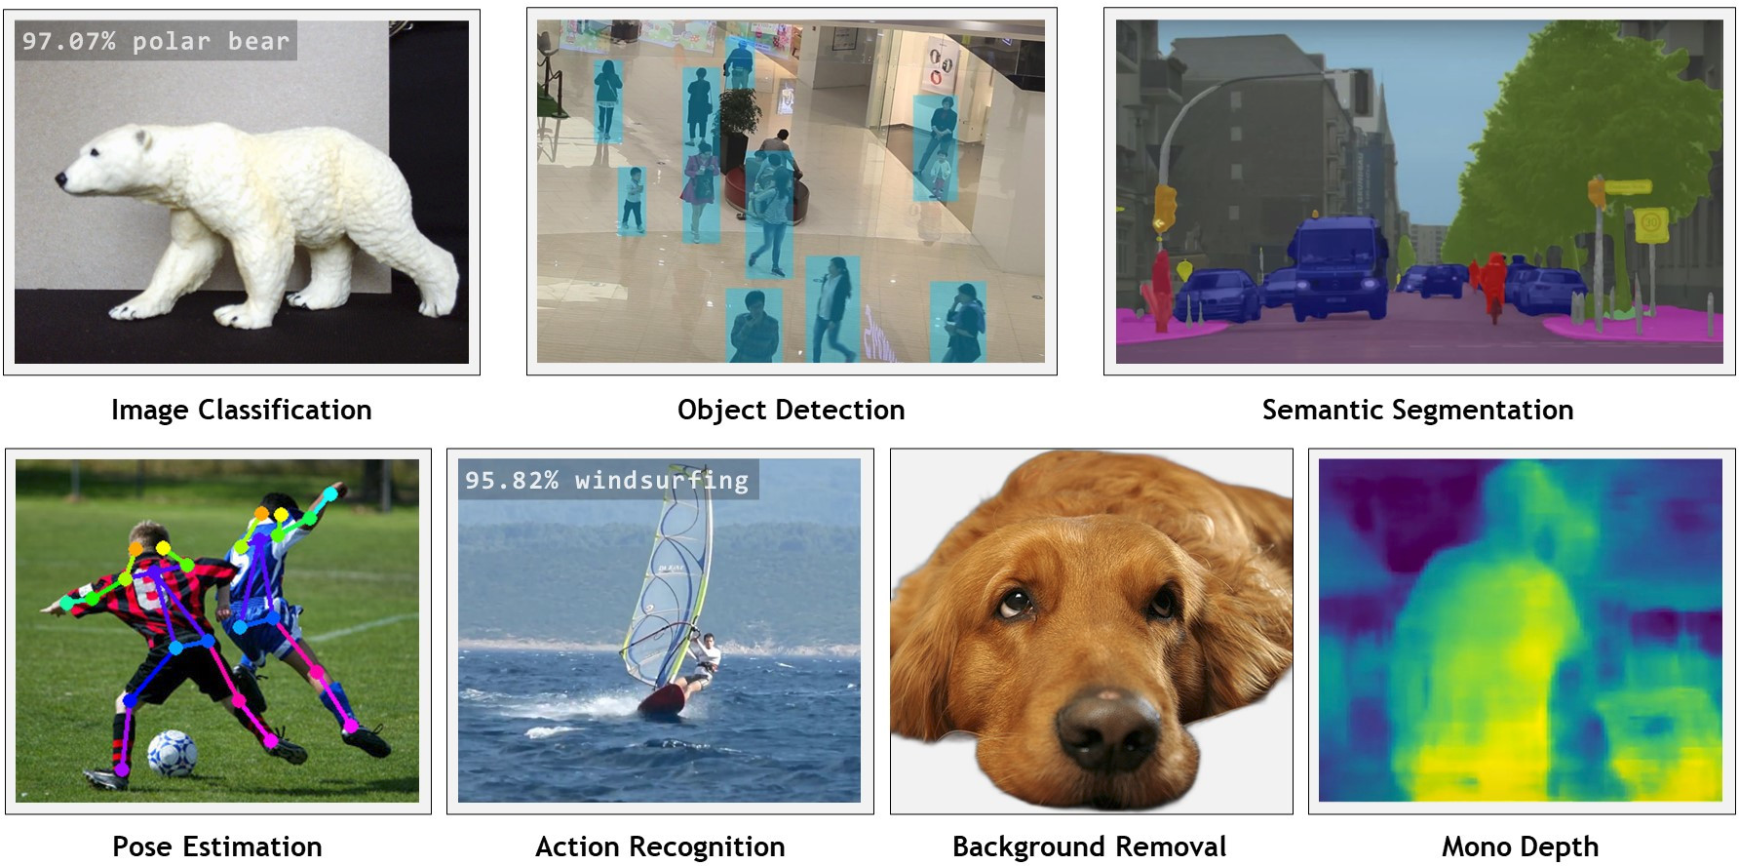
Jetson Inference
Open-source (MIT license)
Ready-to-use examples
Maintained by NVIDIA & the community (Maintainer: Dustin Franklin)
https://github.com/dusty-nv/jetson-inference

Slide 6
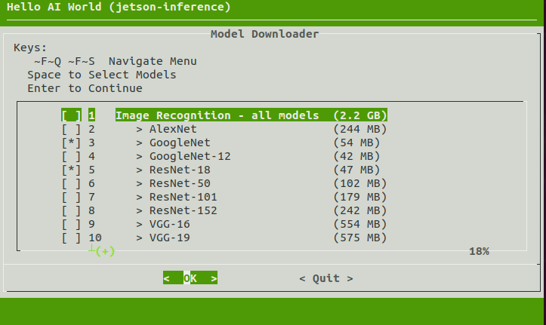
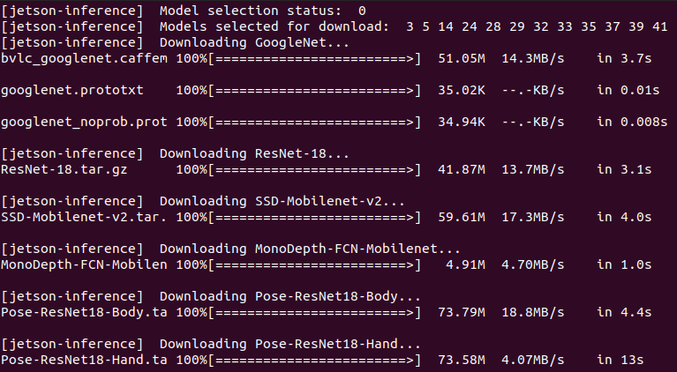
Jetson Inference – Environment
Launching Docker Container
git clone --recursive --depth=1 https://github.com/dusty-nv/jetson-inference cd jetson-inference docker/run.sh
Download Pre-trained Models
cd /jetson-inference/tools/ ./download-models.sh # The downloaded models are located at cd /jetson-inference/data/networks
→ press <Space> to select / deselect models
→ press <Enter> to download selected models

Slide 7
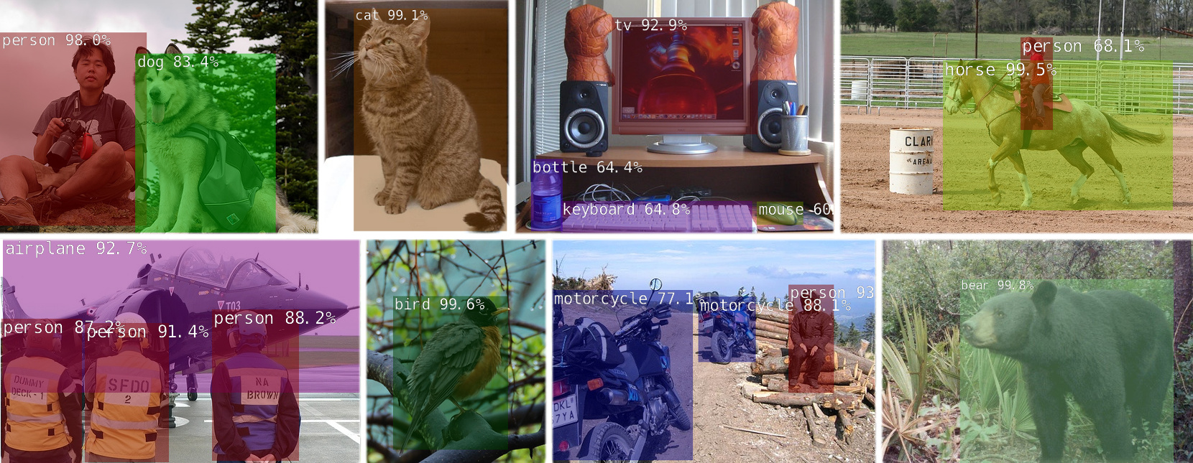
Jetson Inference — Object Detection

Slide 8
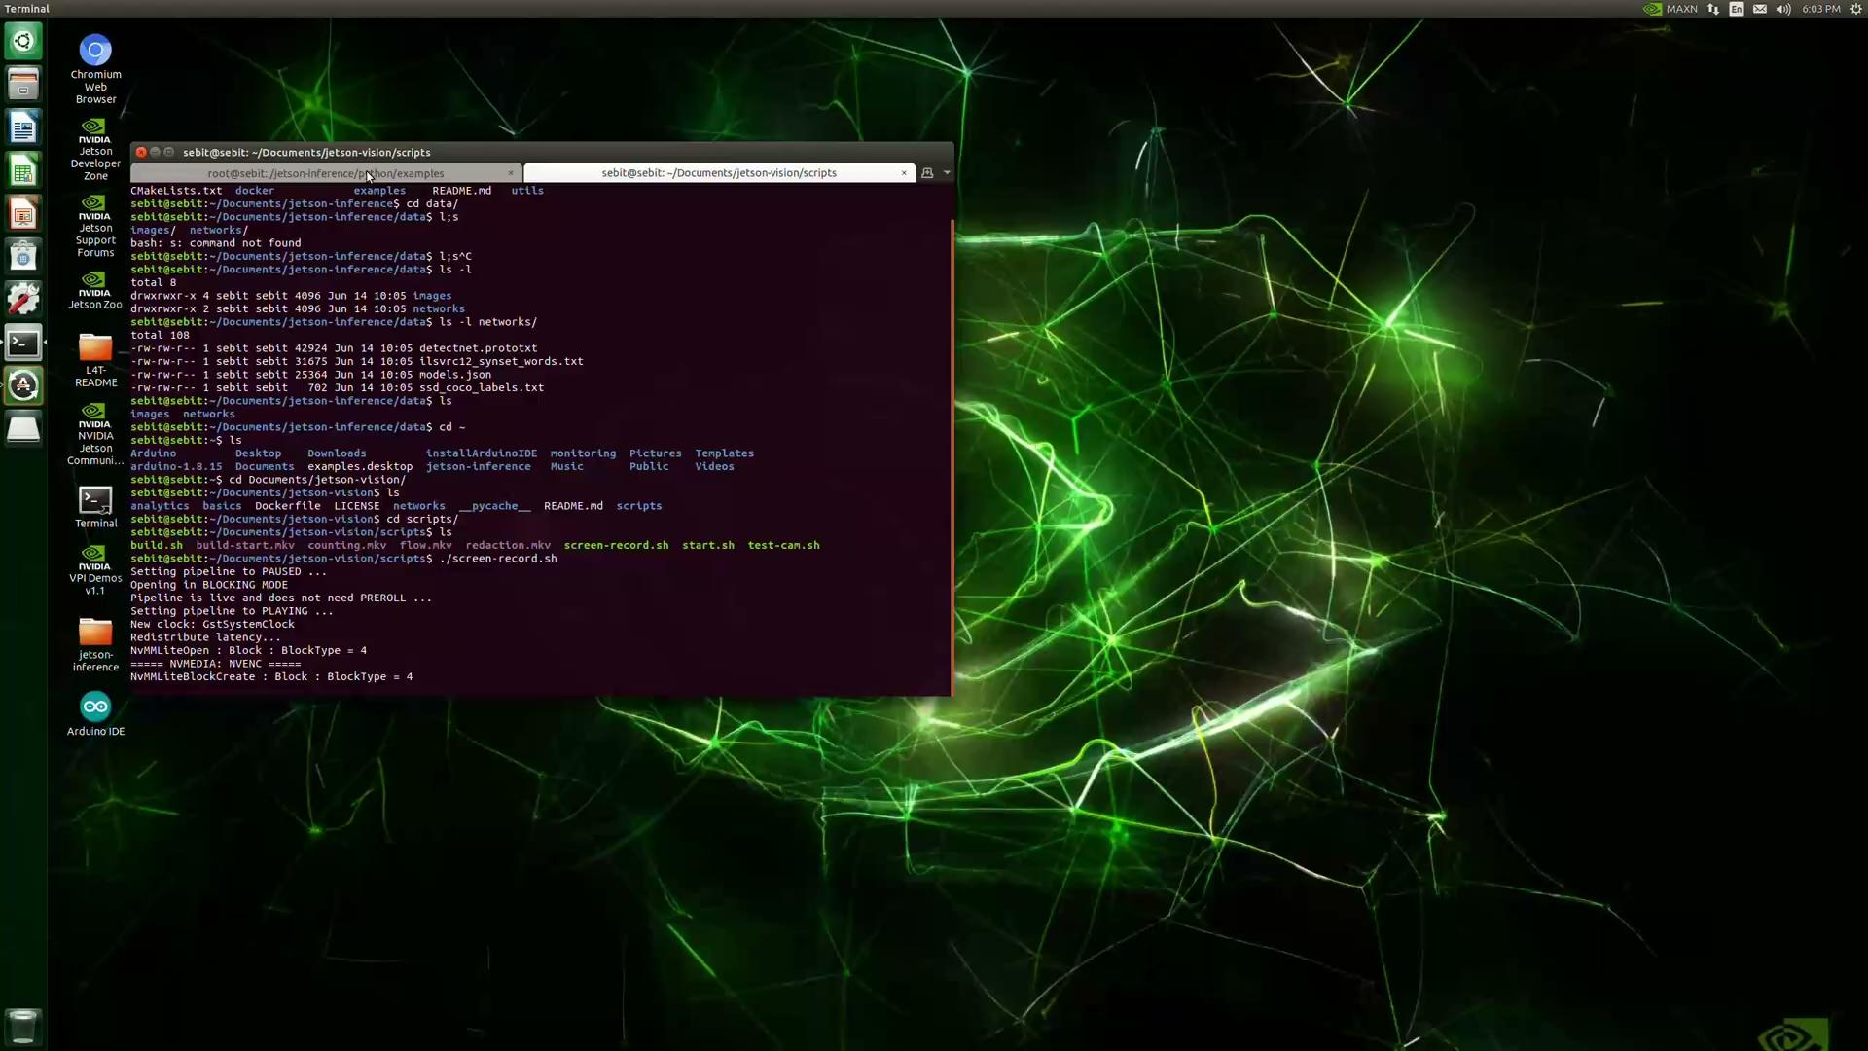
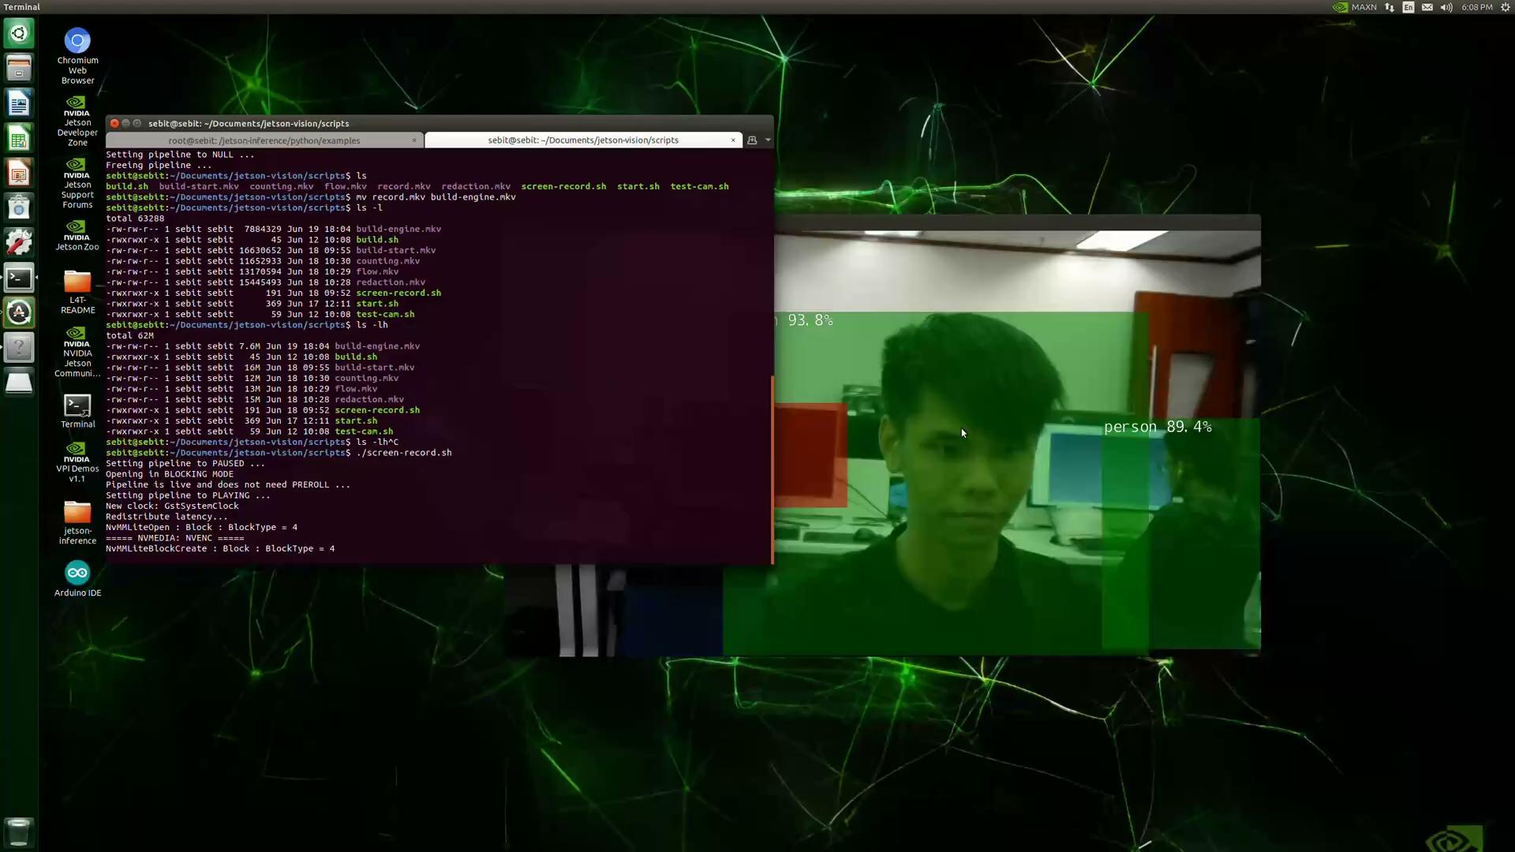
Jetson Inference — Object Detection (cont’d)
Building engine file…
Inference

Slide 9
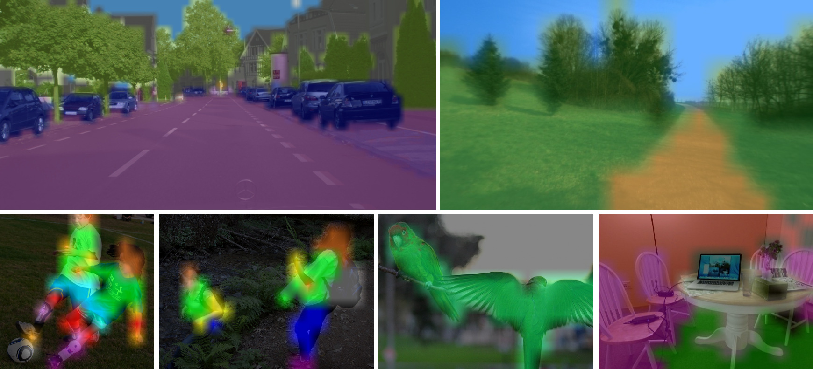
Jetson Inference — Semantic Segmentation

Slide 10
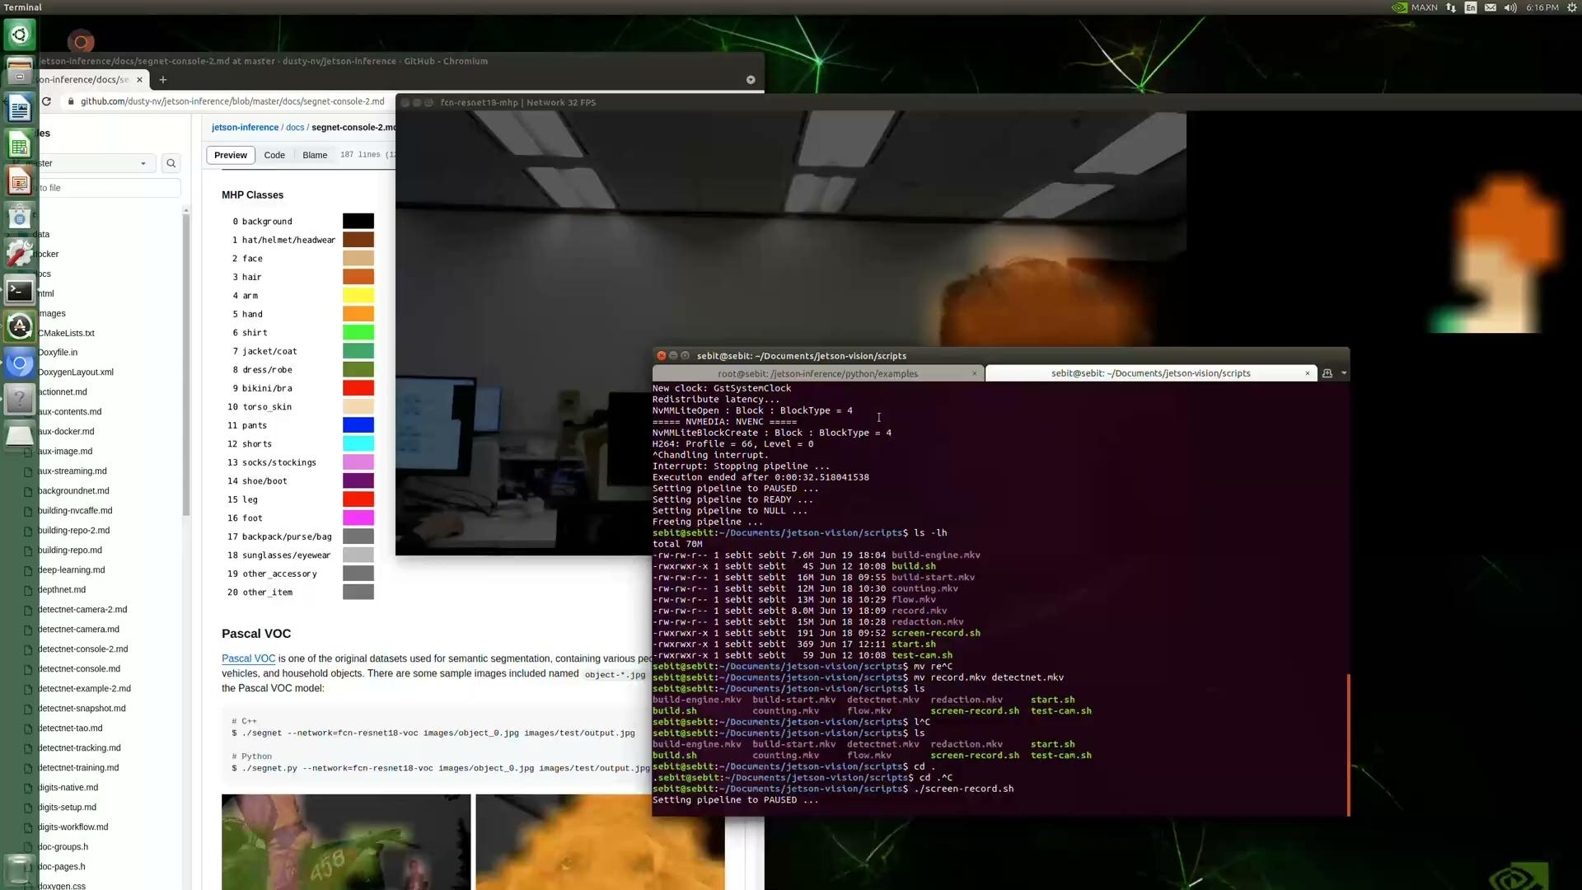
Jetson Inference — Semantic Segmentation (cont’d)

Slide 11
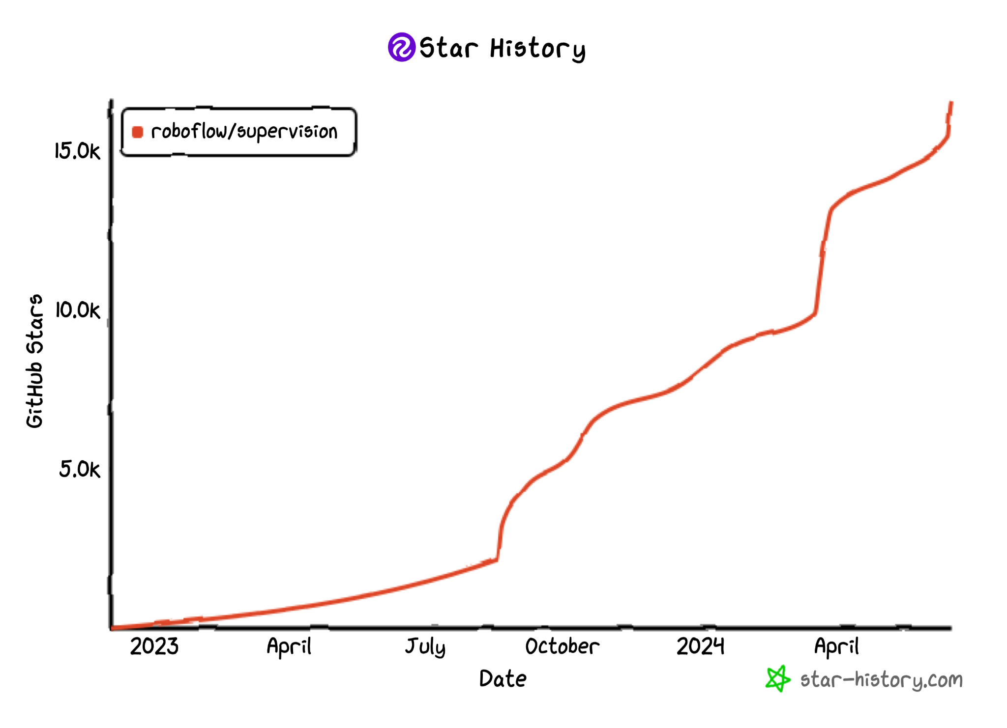

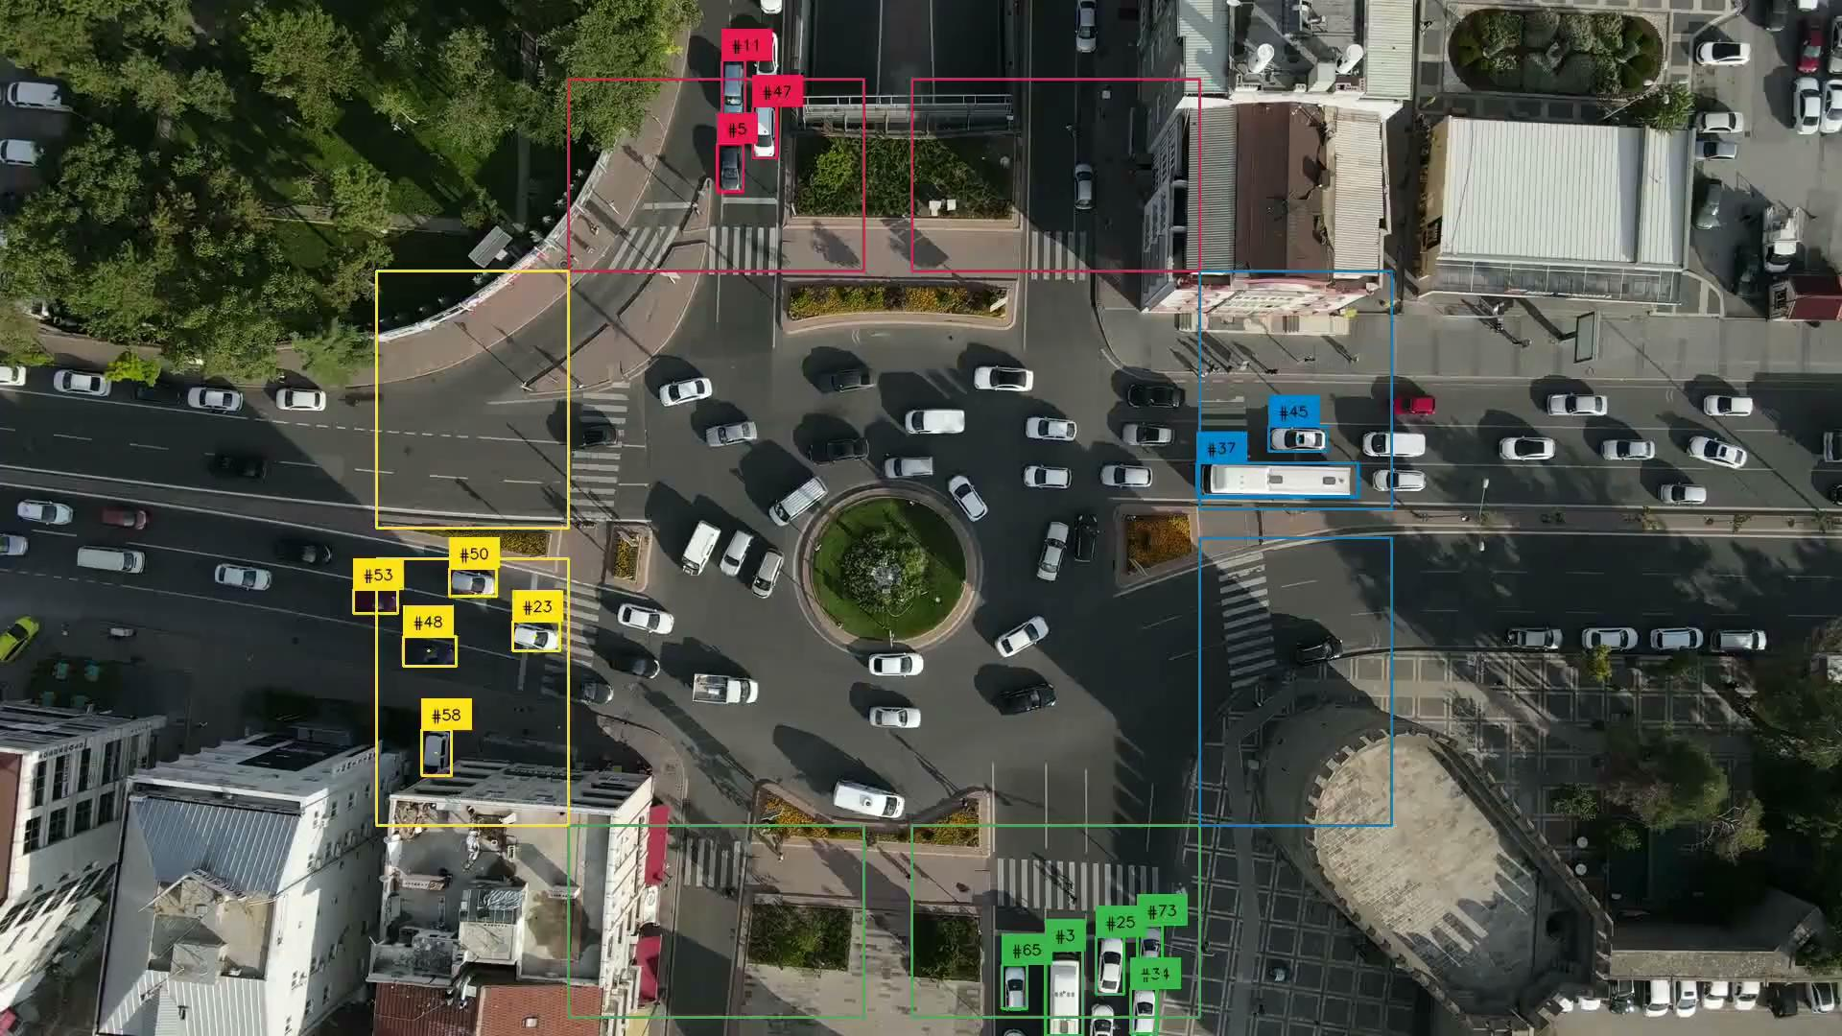
Roboflow Supervision
Open Source reusable computer vision tool (MIT License)
https://github.com/roboflow/supervision

Slide 12
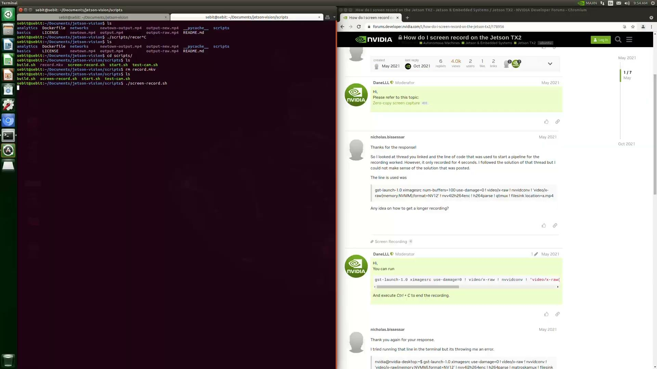
Jetson-Vision — Jetson Inference + Supervision
python 3.6
>= python 3.8
Launching Docker Container
git clone https://github.com/ethanlee928/jetson-vision.git cd jetson-vision ./scripts/build.sh ./scripts/start.sh

Slide 13
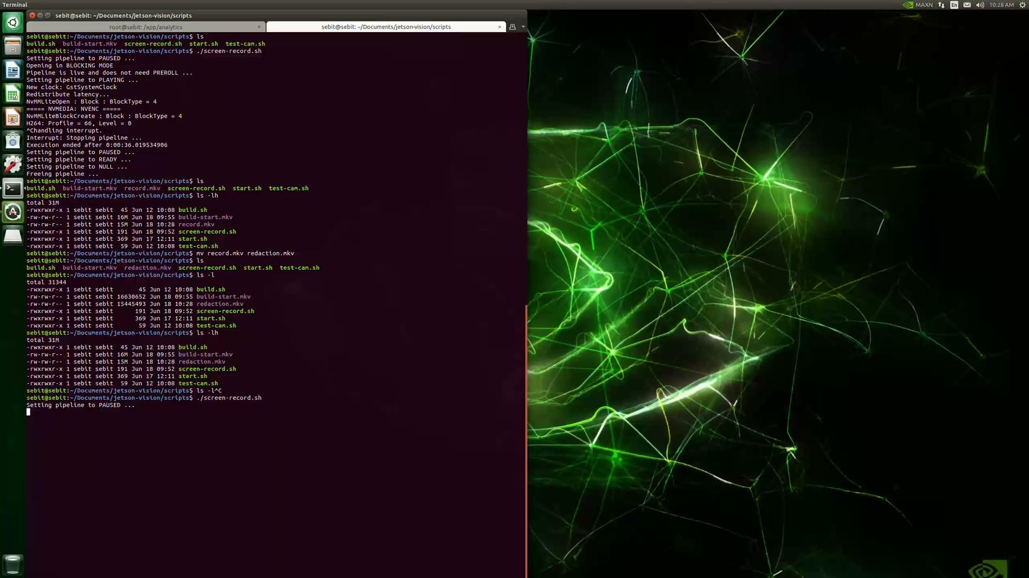
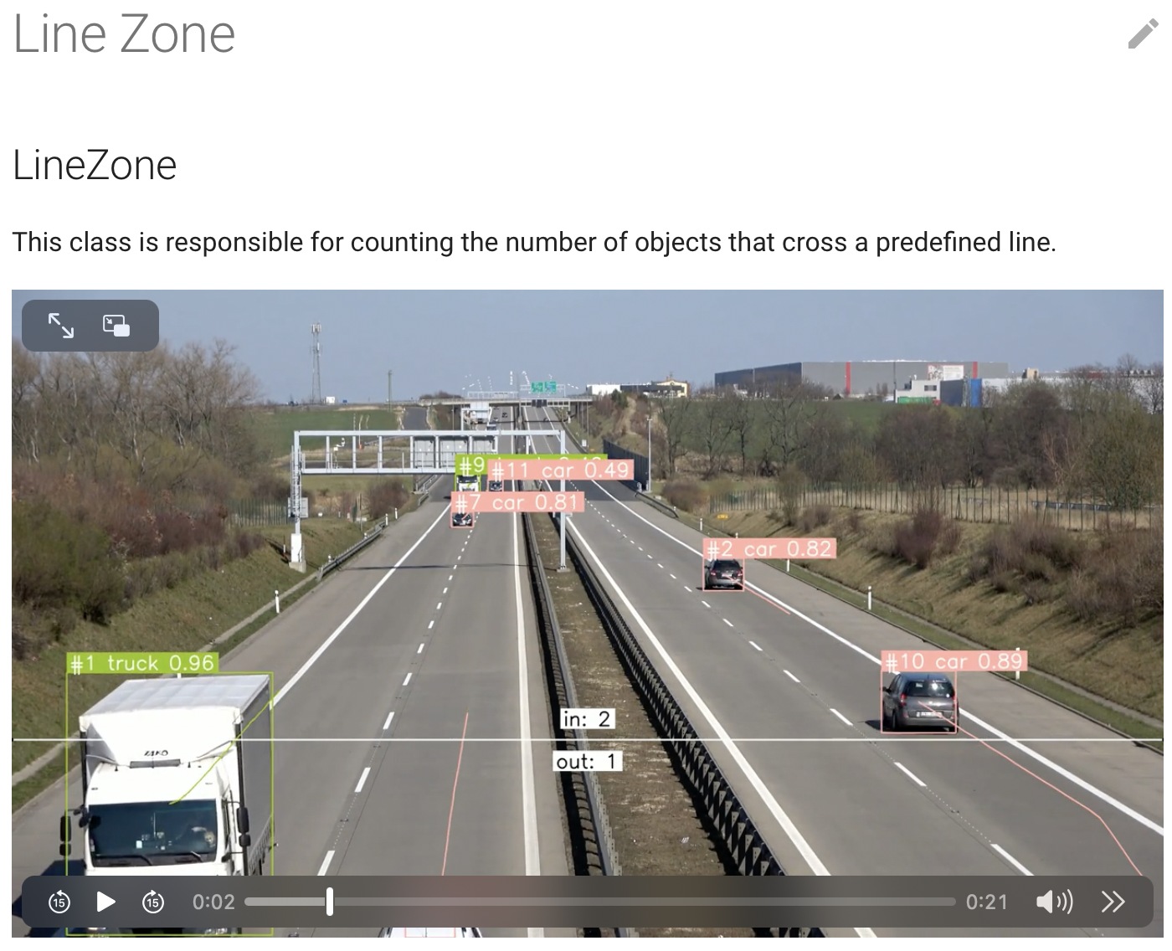
Jetson-Vision — Flow Analysis
https://supervision.roboflow.com/develop/detection/tools/line_zone/

Slide 14
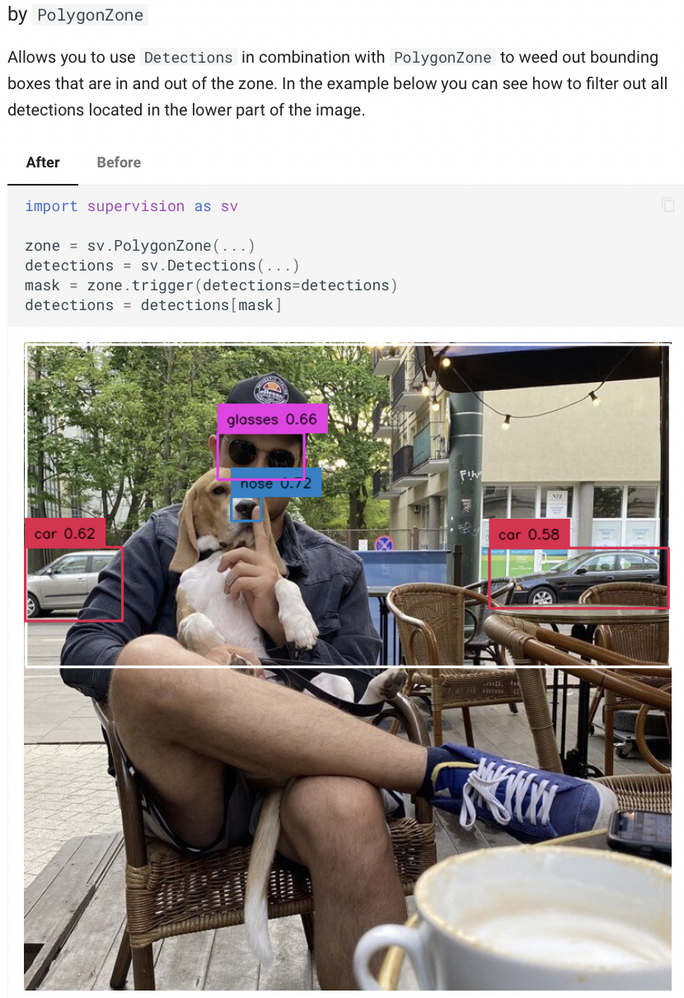
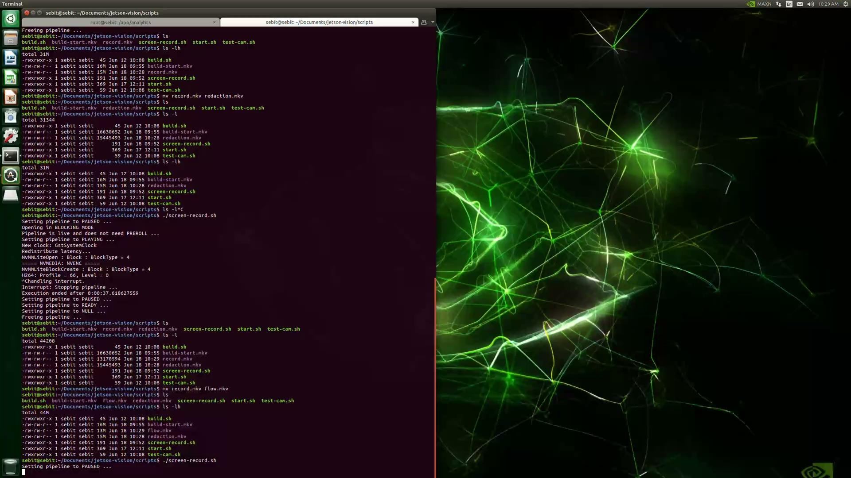
Jetson-Vision — Counting
https://supervision.roboflow.com/latest/detection/tools/polygon_zone/

Slide 15
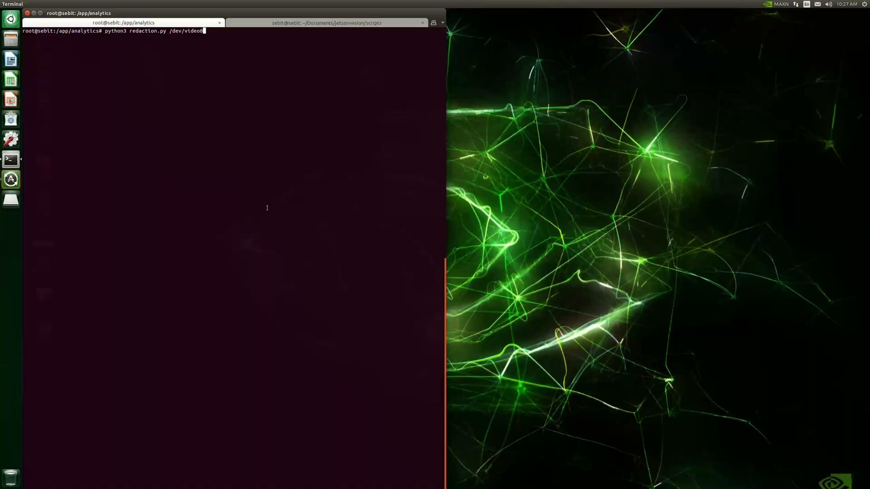
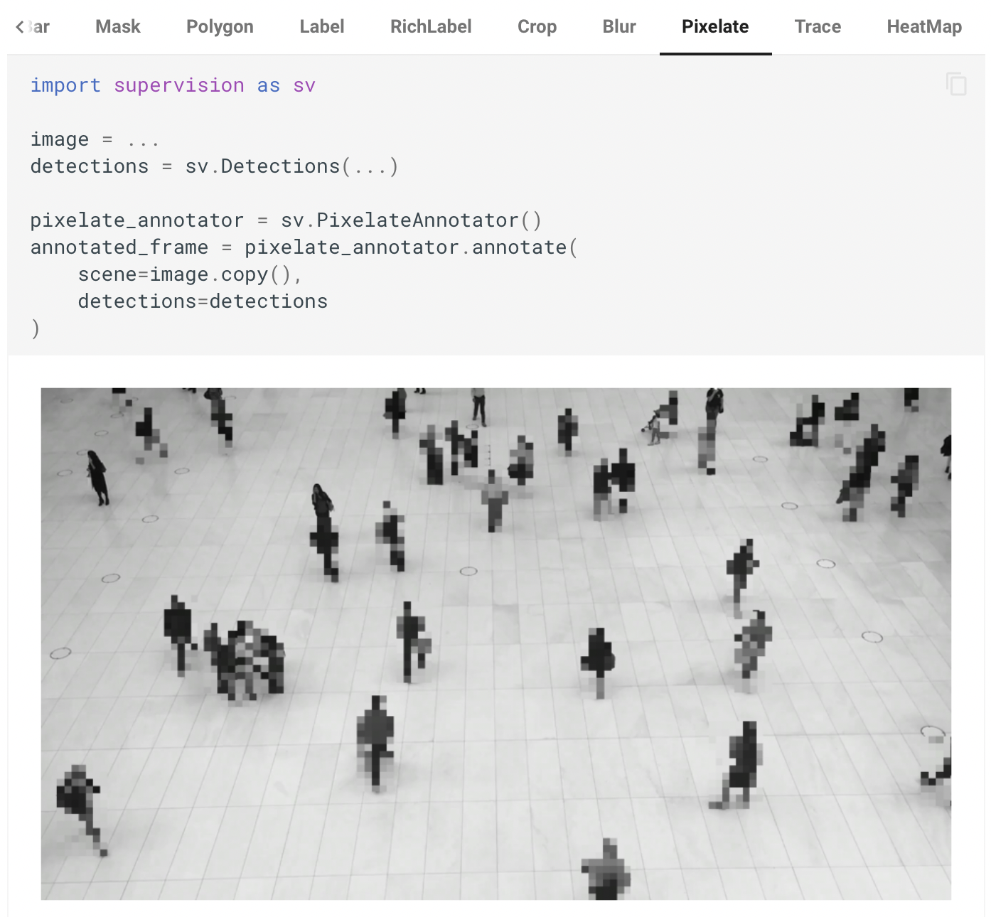
Jetson-Vision — Redaction
https://supervision.roboflow.com/develop/detection/annotators/#supervision.annotators.core.PixelateAnnotator

Slide 16
Discussion
Inference Pipeline
Pros:
Easy to use with hello world examples
Provided training scripts
Open Source with good maintainer
Cons:
Not production ready
Cannot do multi-batch inference
Does not support YOLO
Video Analytic Framework
Pros:
Enables flexible and reusable analysis
Open Source with increasing popularity
Cons:
Visualization performs on CPU → cannot fully utilize hardware

Slide 17
Thank you!
Q & A

Slide 18
Supplementary
How to flash Jetson Nano: https://developer.nvidia.com/embedded/learn/get-started-jetson-nano-devkit#write
jetson-inference and YOLO? Currently not supported. https://forums.developer.nvidia.com/t/run-yolov8-with-jetson-inference-on-jetson-nano/245322
Get detection meta data: https://rawgit.com/dusty-nv/jetson-inference/master/docs/html/python/jetson.inference.html#detectNet
Detection filters: https://supervision.roboflow.com/how_to/filter_detections/

